Slide 1

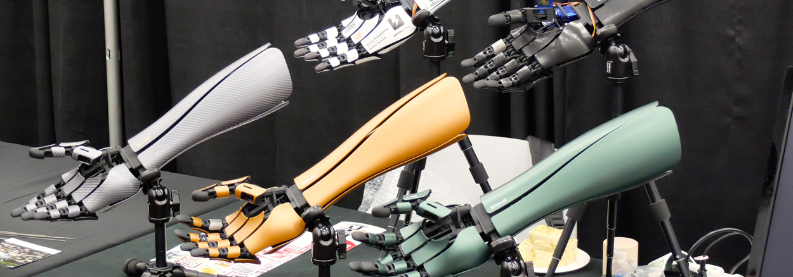
BIONIC LIMBS
What it is and how it helps us in modern society

Slide 2
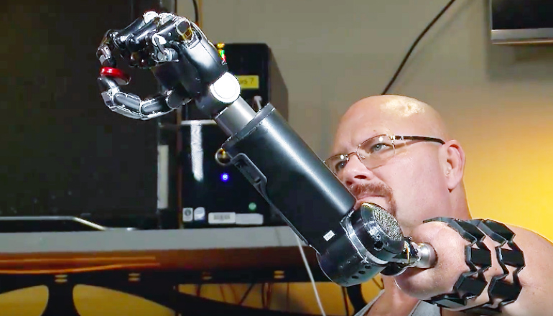
What are Bionic limbs?
In modern society more and more limb amputations are being carried out globally due to numerous reasons like accidents, war casualties or illnesses. This is where Robotic prosthetic limb research can step in and help amputees across the world. These prosthetics are a well-established research area that integrates advanced technology to achieve the movement and appearance of a real limb. This research was created to help amputees have enhanced social interactions and to live a comfortable amputee’s life

Slide 3
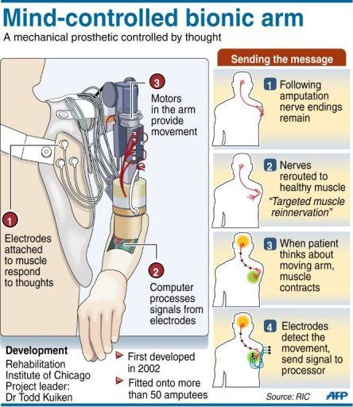
How do Bionic Limbs work?
There are two methods in which Bionic Prosthetics work:
Bionic prosthetics technology works by picking up specific electrical impulses from muscles through sensors that touch the skin and translate them to actions such as grasping motions. Movements are tied to the actual muscles that would have performed that movement prior to the amputation.
Using advanced but currently available bionics, some amputees have been given the chance to control artificial limbs the same way they would their real ones: with their mind. This process begins by implanting sensors in the user’s muscles that can communicate with their prosthetic. Using a method called Targeted Muscle Reintegration (TMR), these sensors rewire the user’s nervous system by transferring nerves controlled by the amputated limb to alternative muscle sites

Slide 4
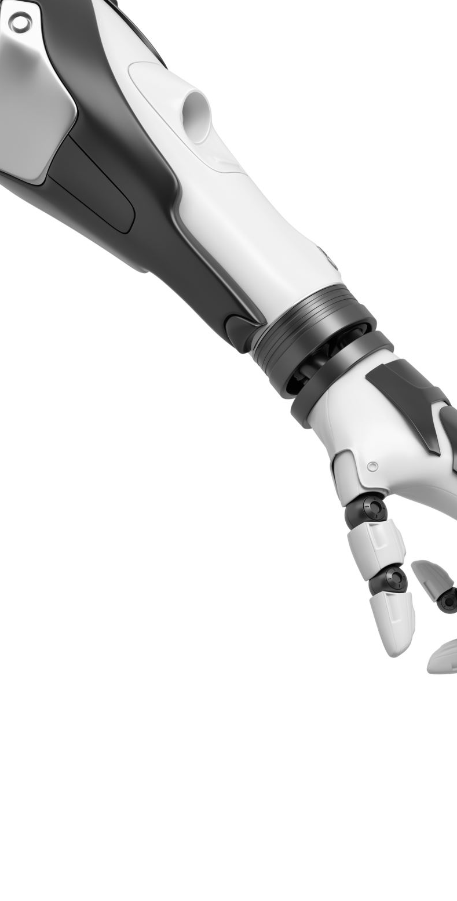
Positives of Bionic Limbs
Increased prosthetic use
Improved range of joint movement
Easy and quick attachment and removal

Slide 5
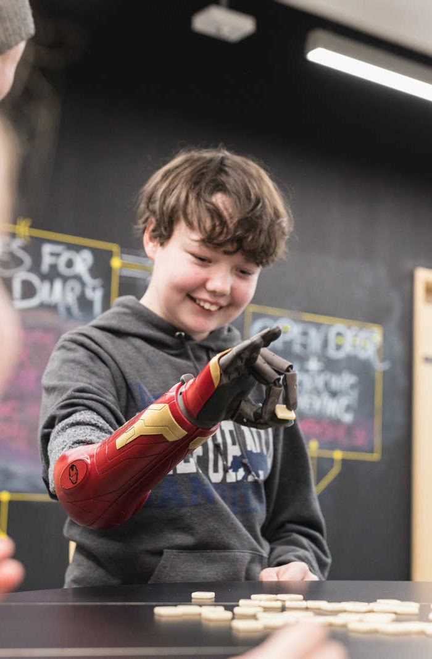
Disadvantages of Bionic Limbs
Heavier than a traditional prosthetic
Frequent maintenance
Noisy
Unreliable control
Expensive

Slide 6
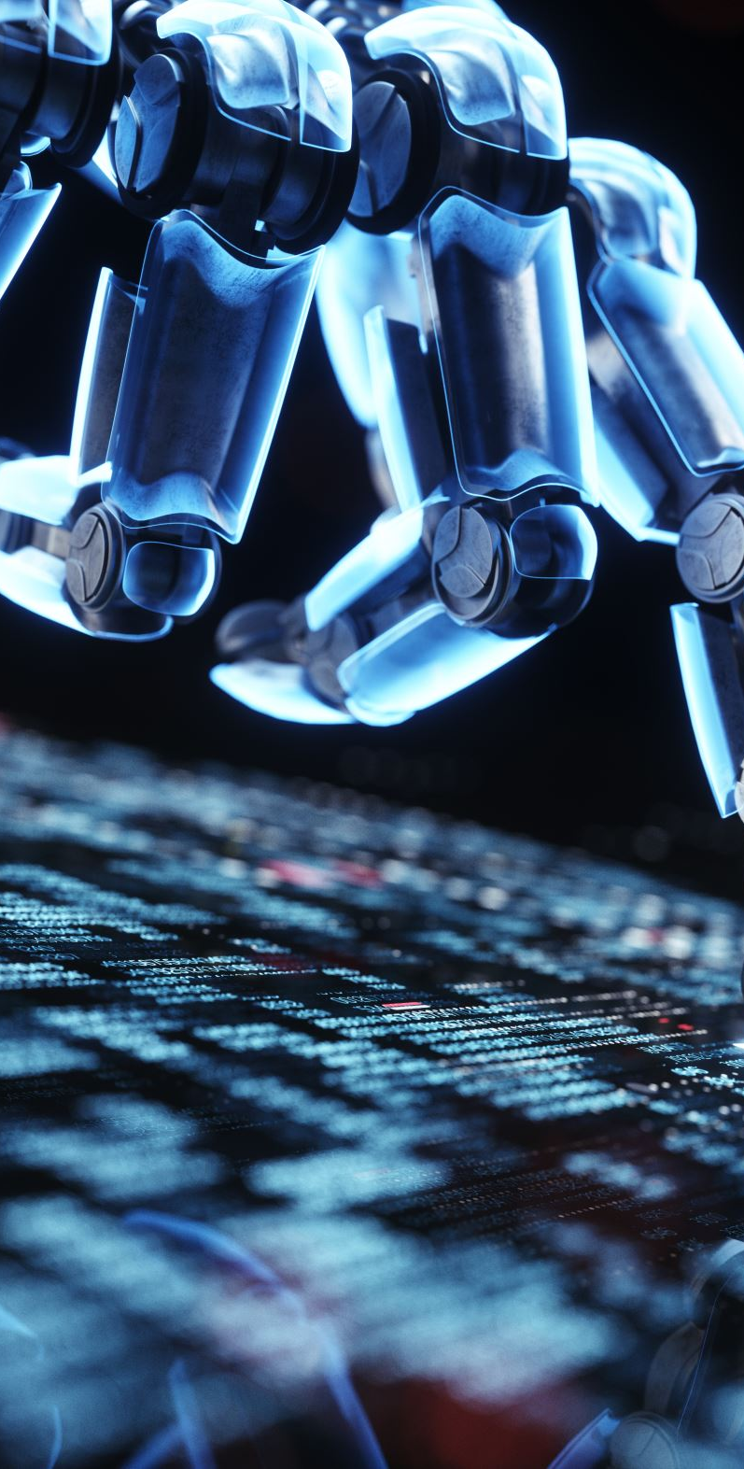
In conclusion
Recent and projected advancements in bionics and artificial limb technology will continue to change people’s lives in the coming years. Right now, the future of this technology is limitless

Slide 7
references
https://consultqd.clevelandclinic.org/bionic-arms-neurorobotic-sensory-motor-fusion-restores-natural-behaviors/
https://www.hindawi.com/journals/jr/2018/1085980/
https://researchfeatures.com/future-bionic-limbs/
https://www.science.org/content/article/minimuscles-let-amputees-control-robot-hand-their-minds#:~:text=Most%20current%20robotic%20prostheses%20work,would%20have%20controlled%20their%20fingers.

